Slide 1
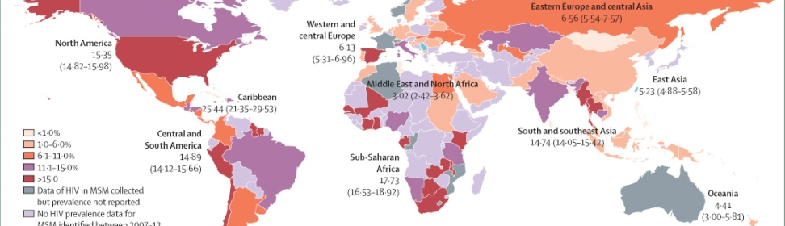
The Importance of an HIV Vaccine in Latin America
An HIV Vaccine to Prevent HIV acquisition
IAS 2019
Jorge Sanchez, MD, MPH
Research reported in this publication was supported by the National Institute of Allergy And Infectious Diseases of the National Institutes of Health under Award Number UM1A1068614. The content is solely the responsibility of the authors and does not necessarily represent the official views of the National Institutes of Health.

Slide 2
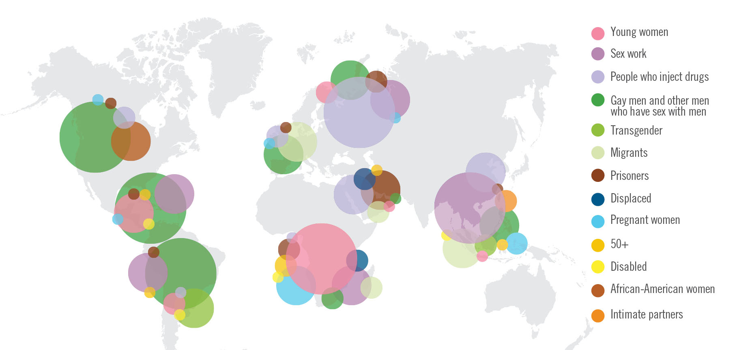
Global HIV Epidemic:
The Importance of Location and Population
avac.org/infographics 2013

Slide 3
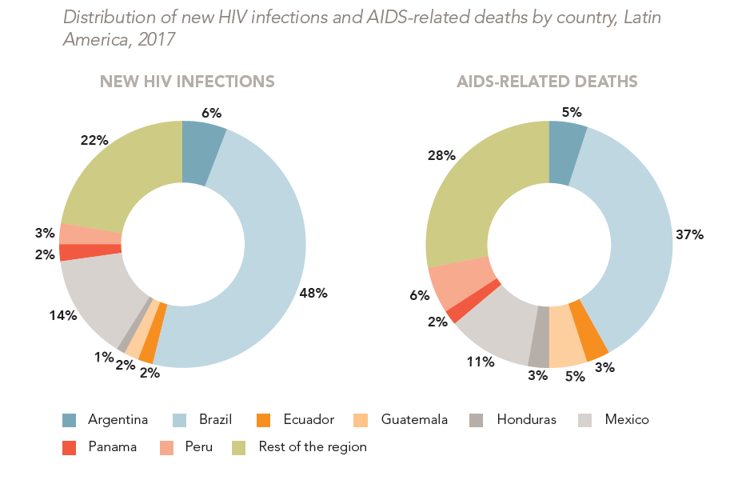
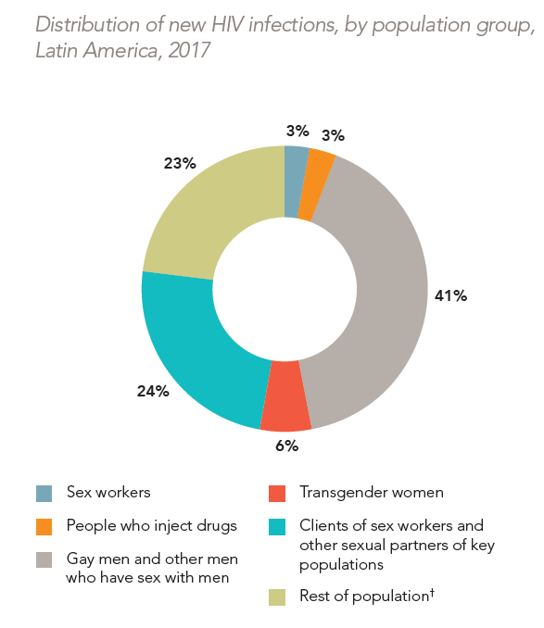
Distribution of New HIV Infections by Country and Population Group, Latin America 2017
UNAIDS 2018 Estimates
UNAIDS special analysis, 2018

Slide 4
Four Prevention Opportunities
Cohen et al., JCI, 2008
Cohen et al., JIAS ,2008
UNEXPOSED
UNINFECTED
EXPOSED
INFECTED
(precoital/coital)
(postcoital)
Behavioral,
Structural
Vaccines
Microbicides
ART PrEP
Antibodies
Vaccines
ART PEP
Treatment Of HIV
to Reduce Infectivity
STDS
Circumcision
Condoms
YEARS
HOURS
72h
YEARS
Notes:
Vaccine – neutral antibodies

Slide 5
HVTN in Peru
HVTN Studies | Screened | Enrolled | Status
HVTN 910, assessment of the persistence of HIV vaccine-induced seropositivity | 48 | 46 | Enrolling
HVTN 914, measuring immune responses and activation levels in the foreskin and rectosigmoid mucosa | 72 | 29 | Completed
HVTN 802, to describe the response to ART in former vaccine study volunteers | 42 | 29 | Enrolling
HVTN 404, to follow Phase 1/2 vaccine study volunteers who became HIV infected | 6 | 6 | Enrolling
HVTN 084,⁸³ phase 1b trial to examine antigenic competition of two vaccine candidates | 100 | 32 | Completed
HVTN 205,⁸⁴ phase 2a trial a prime-boost (plasmid DNA and vector) vaccine regimen | 131 | 48 | Completed
HVTN 403, to follow vaccine study volunteers who became HIV infected | 4 | 4 | Completed
HVTN 502,⁵⁴ phase 2b study of the MRKAd5 HIV-1 in adults at high risk of HIV | 882 | 470 | Completed
HVTN 504, to follow STEP study volunteers | 368 | 368 | Completed
HVTN 069,⁸² to evaluate a prime (DNA plasmid) boost (Ad5) vaccines in healthy Ad5 (-) adults | 40 | 18 | Completed
HVTN 905-2, to collect peripheral blood from HVTN 502 and HVTN 050 volunteers | 44 | 40 | Completed
HVTN 050,⁸¹ phase I study of the MRKAd5 HIV-1 gag vaccine in healthy adults | 49 | 30 | Completed

Slide 6
Summary
  Despite prevention efforts, MSM in Latin America remain at substantial risk of HIV acquisition
  In the Latin America rates of infection among young MSM continue to rise.
  Although data among transgender women is scant in the established HIV surveillance systems, studies indicate especially high prevalence in this group
  Deployment of Prevention Strategias such us Treatment as Prevention and PrEP is slow.
  There is a momentum for finding an HIV vaccine

Slide 7


Slide 8

HVTN 706/HPX2008 Protocol Team Acknowledgements
Janssen Team
Sabrina Spinosa Guzman, Protocol Leadership Chair
Ludo Lavreys, Study Responsible Physician
Vicky Cárdenas, Study Responsible Scientist
Frank Tomaka, Franchise Clinical Leader
Carla Truyers, Senior Manager Clinical Biostatistics
Steven Nijs, Senior Scientific Director Biostatistics
Zelda Euler, Senior Scientist
Wolf Ribbens, Senior Associate Scientist
Raphaele Roten, Medical Safety Officer
Lorenz Scheppler, Global Regulatory Affairs
Olive Yuan, Associate Director Data Management
Caroline Hodin, Global Data Manager Specialist
Wouter Vandermeiren, Senior Global Data Manager
Chris McShane, GCDO Clinical Program Leader
Karen Buleza, GCDO Clinical Trial Leader
Johan De Decker, Senior Clinical Trial Manager
Cornelia Linthicum, Senior Clinical Trial Manager
Eveline Hoste, Associate Director Reg Medical Writing
Anick Vandingenen, Associate Director Reg Medical Writing

Slide 9
HVTN 706/HPX2008 Protocol Team Acknowledgements
HVTN Team
Larry Corey, Principle Investigator
Jim Kublin, Principal Staff Scientist
Susan Buchbinder, HVTN Chair
Philipp Mann, Protocol Team Leader
Julia Hutter, DAIDS Medical Officer
Megan Jones, Clinical Safety Specialist
India Tindale, Clinical Trials Manager
Niles Eaton, Director of Site Operations
Laurie Rinn, Regulatory Associate
Mariel Franklin, Regulatory Project Manager
Stephaun Wallace, Community Engagement Project Manager
Aziel Gangerdine, Director of Communication
Steven Wakefield, Director of External Relations
Robert De La Grecca, Regional Medical Liaison
Lab
John Hural, Associate Director of Laboratory Operations
Mike Stirewalt, Quality Assurance Program Manager
Katheryn Dougherty, Quality Assurance Associate
Jennifer Hanke, Protocol Operations Coordinator
Lisa Sanders, Protocol Operations Coordinator
SCHARP
Jessica Andriesen, Associate Director of Data Operations
Lisa Bunts, Data Operations Project Manager
Lauren Young, Lab Data Manager
Nada Aboulhosn, Research Project Manager
Kate Ostbye, Sr. Manager, Programming
Julie Stofel, Manager, Clinical Programming
Craig Chin, Prin. Clinical Programmer
Brad Fischer, Sr. Clinical Programmer
Abby Isaacs, Statistical Research Associate

